Slide 1
PCA
Data set: IBM-HR-Employee-NoAttrition
Richa Singh
2018.9.17

Slide 2
Introduction
Data: IBM-HR-Employee-NoAttrition
Rows: The 1233 observations describe the Employees of IBM.
Columns: 32 variables
Sub, Age, BusinessTravel,Department, Monthly Income, Daily Rate, Hourly Rate, MonthlyRate, DistanceFromHome, PerformanceRating, Education, JobInvolvement, Job level, StockOptionLevel, PercentSalaryHike, TotalWorkingYears, TrainingTimesLastYear, WorkLifeBalance, WorkLifeBalance, YearsAtCompany, YearsInCurrentRole, YearsSinceLastPromotion, Years With CurrManager, EnvironmentSatisfaction, JobSatisfaction, RelationshipSatisfaction, Attrition,Field, Gender, JobRole, MaritalStatus and OverTime.
Research Question
How do all 1233 employees differ on the variables like Gender type vs Department ? Job level vs MonthlyIncome ? etc.

Slide 3
Subj Age Attrition BusinessTravel Department EducationField Gender JobRole
1 2 49 No Travel_Frequently Research & Development Life Sciences Male Research Scientist
2 4 33 No Travel_Frequently Research & Development Life Sciences Female Research Scientist
3 5 27 No Travel_Rarely Research & Development Medical Male Laboratory Technician
4 6 32 No Travel_Frequently Research & Development Life Sciences Male Laboratory Technician
5 7 59 No Travel_Rarely Research & Development Medical Female Laboratory Technician
6 8 30 No Travel_Rarely Research & Development Life Sciences Male Laboratory Technician
MaritalStatus OverTime MonthlyIncome DailyRate HourlyRate MonthlyRate DistanceFromHome PerformanceRating
1 Married No 5130 279 61 24907 8 4
2 Married Yes 2909 1392 56 23159 3 3
3 Married No 3468 591 40 16632 2 3
4 Single No 3068 1005 79 11864 2 3
5 Married Yes 2670 1324 81 9964 3 4
6 Divorced No 2693 1358 67 13335 24 4
Education JobInvolvement JobLevel StockOptionLevel NumCompaniesWorked PercentSalaryHike TotalWorkingYears
1 1 2 2 1 1 23 10
2 4 3 1 0 1 11 8
3 1 3 1 1 9 12 6
4 2 3 1 0 0 13 8
5 3 4 1 3 4 20 12
6 1 3 1 1 1 22 1
TrainingTimesLastYear WorkLifeBalance YearsAtCompany YearsInCurrentRole YearsSinceLastPromotion
1 3 3 10 7 1
2 3 3 8 7 3
3 3 3 2 2 2
4 2 2 7 7 3
5 3 2 1 0 0
6 2 3 1 0 0
YearsWithCurrManager EnvironmentSatisfaction JobSatisfaction RelationshipSatisfaction
1 7 3 2 4
2 0 4 3 3
3 2 1 2 4
4 6 4 4 3
5 0 3 1 1
6 0 4 3 2

Slide 4
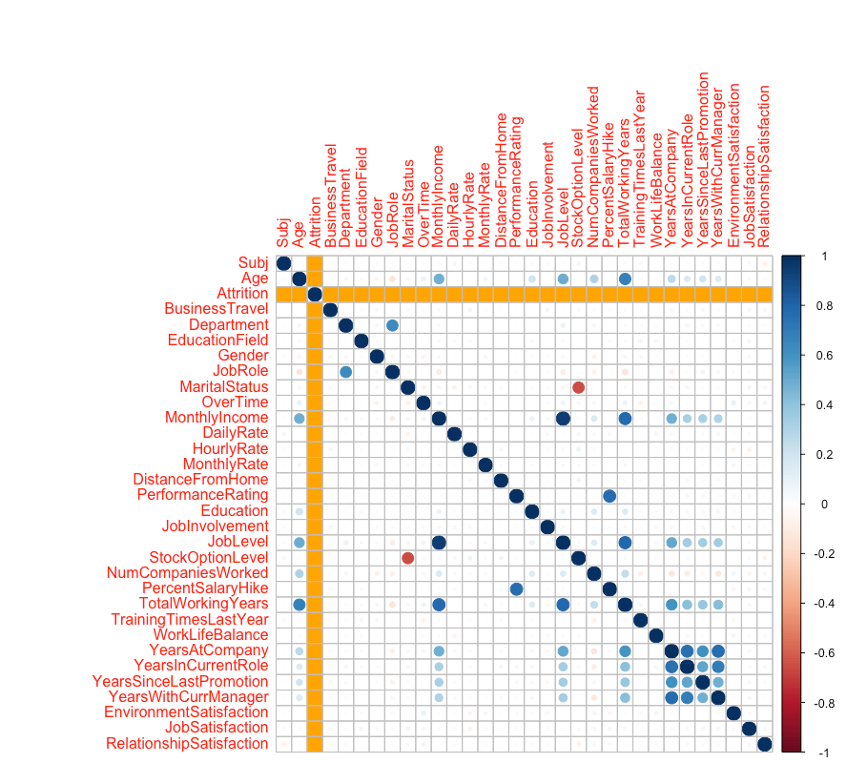
Correlation plot

Slide 5
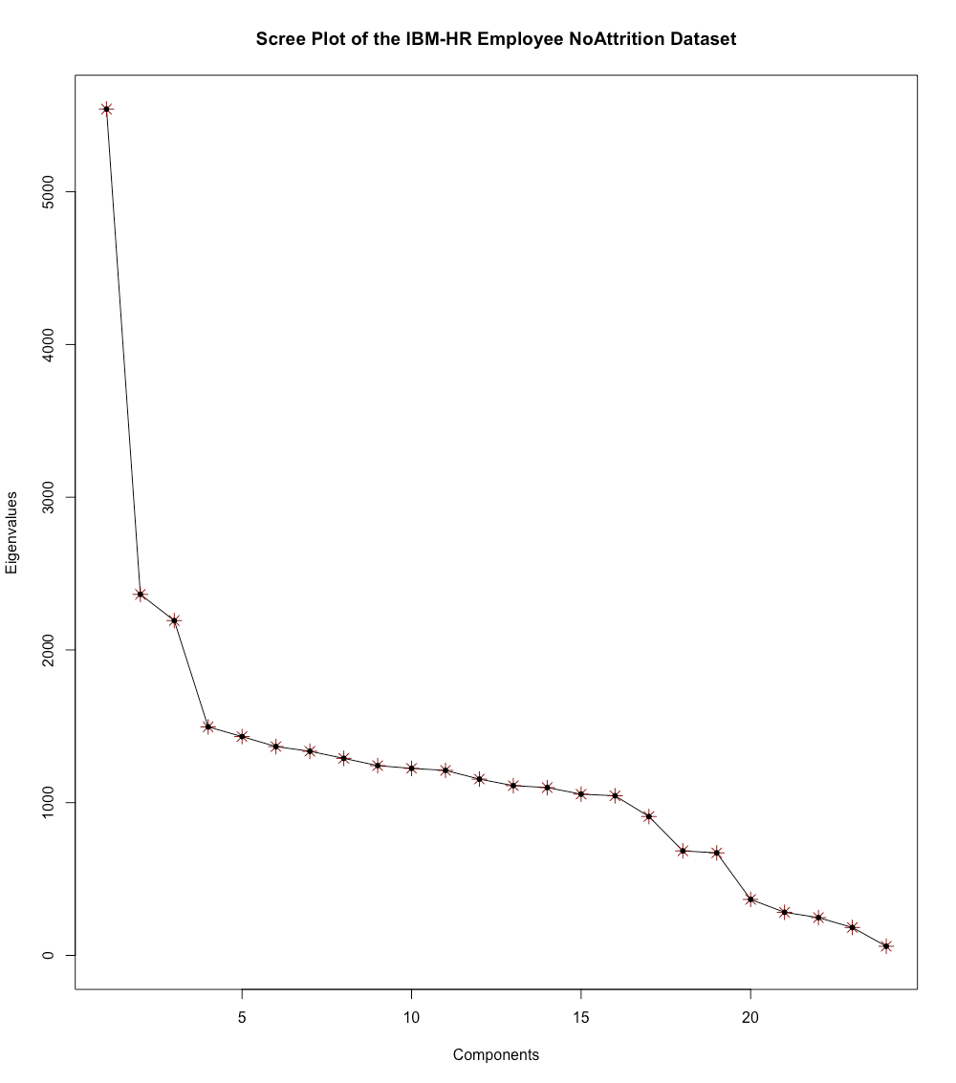
Scree plot

Slide 6
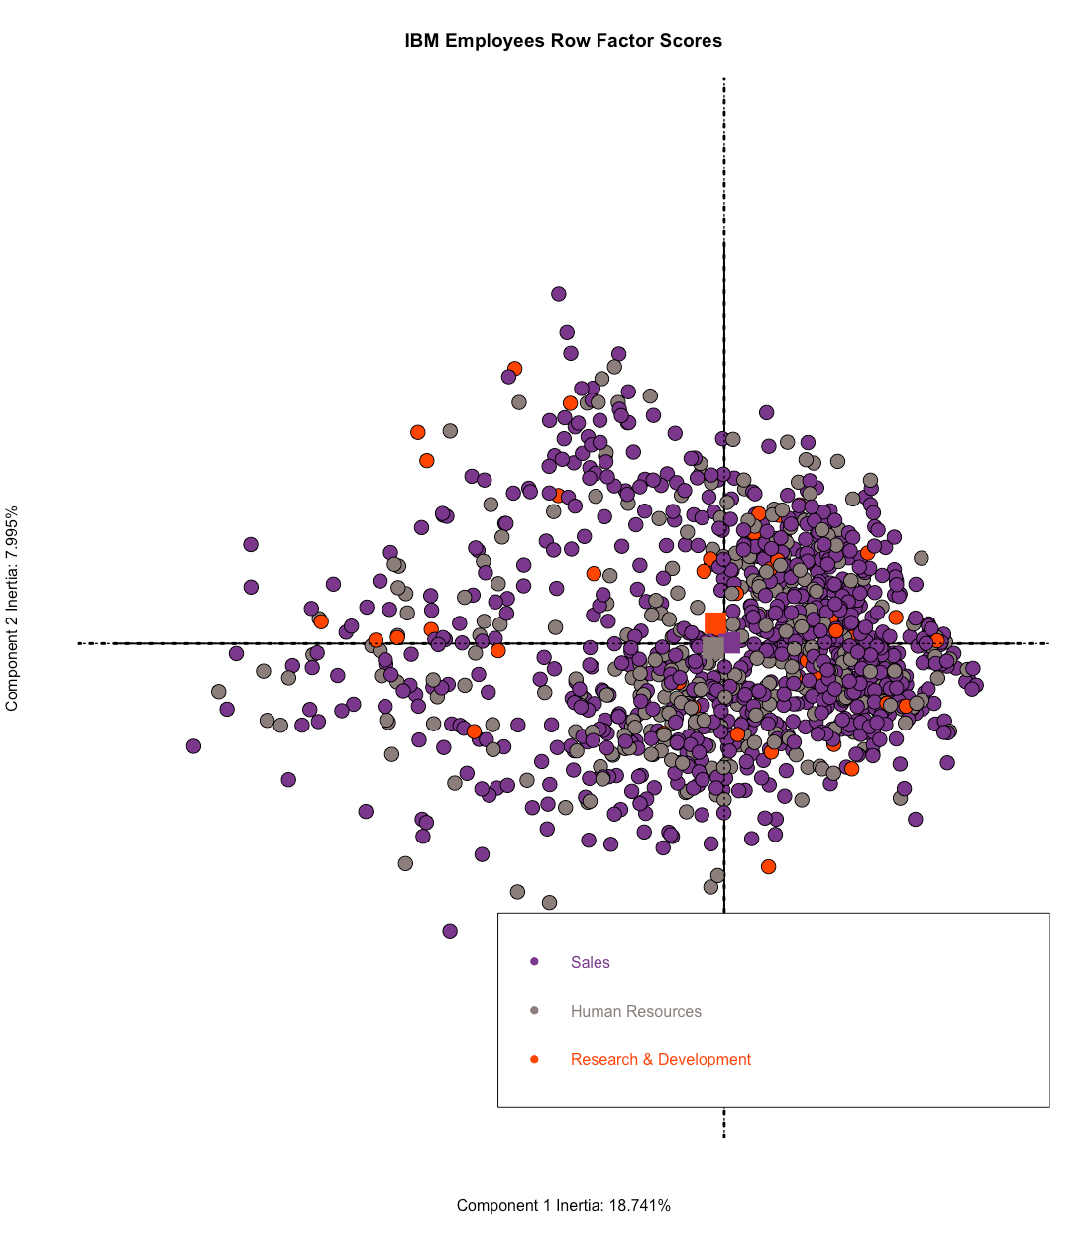
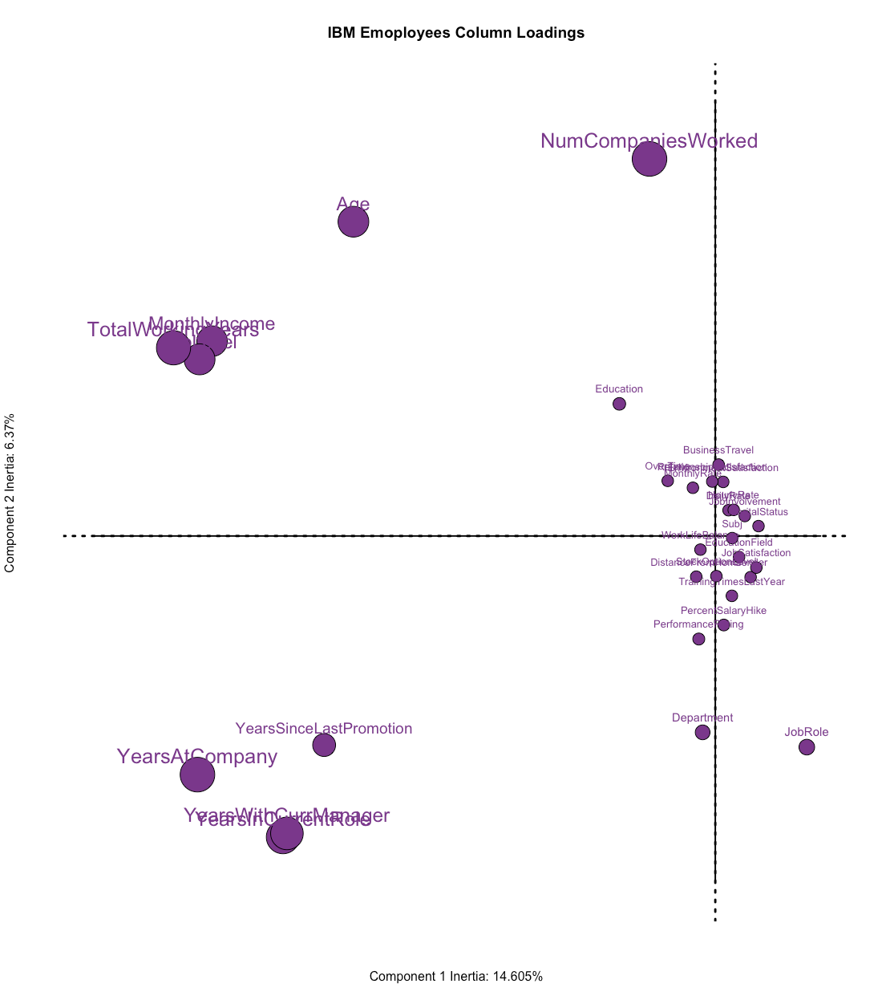
Factor scores and Loadings

Slide 7
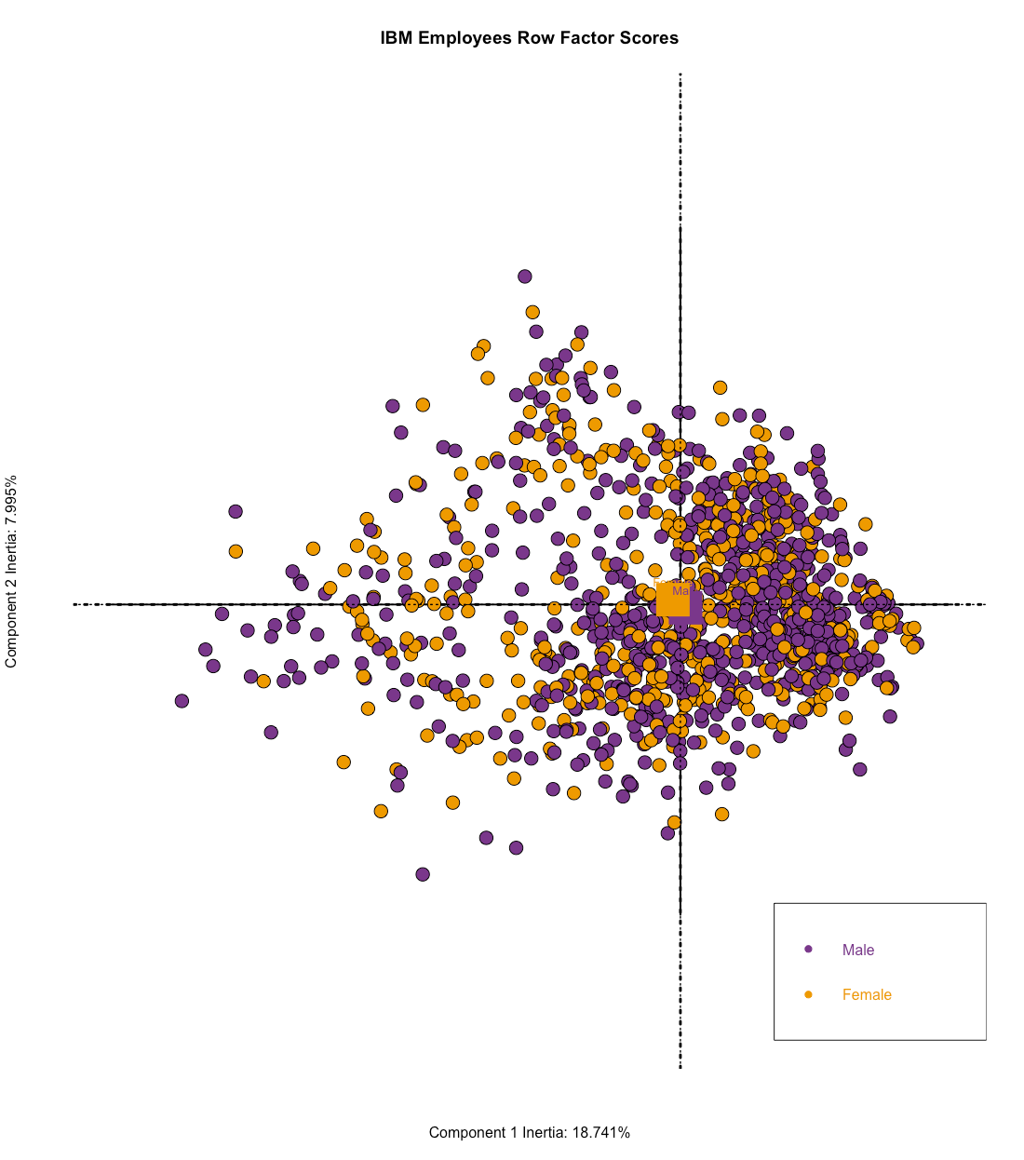
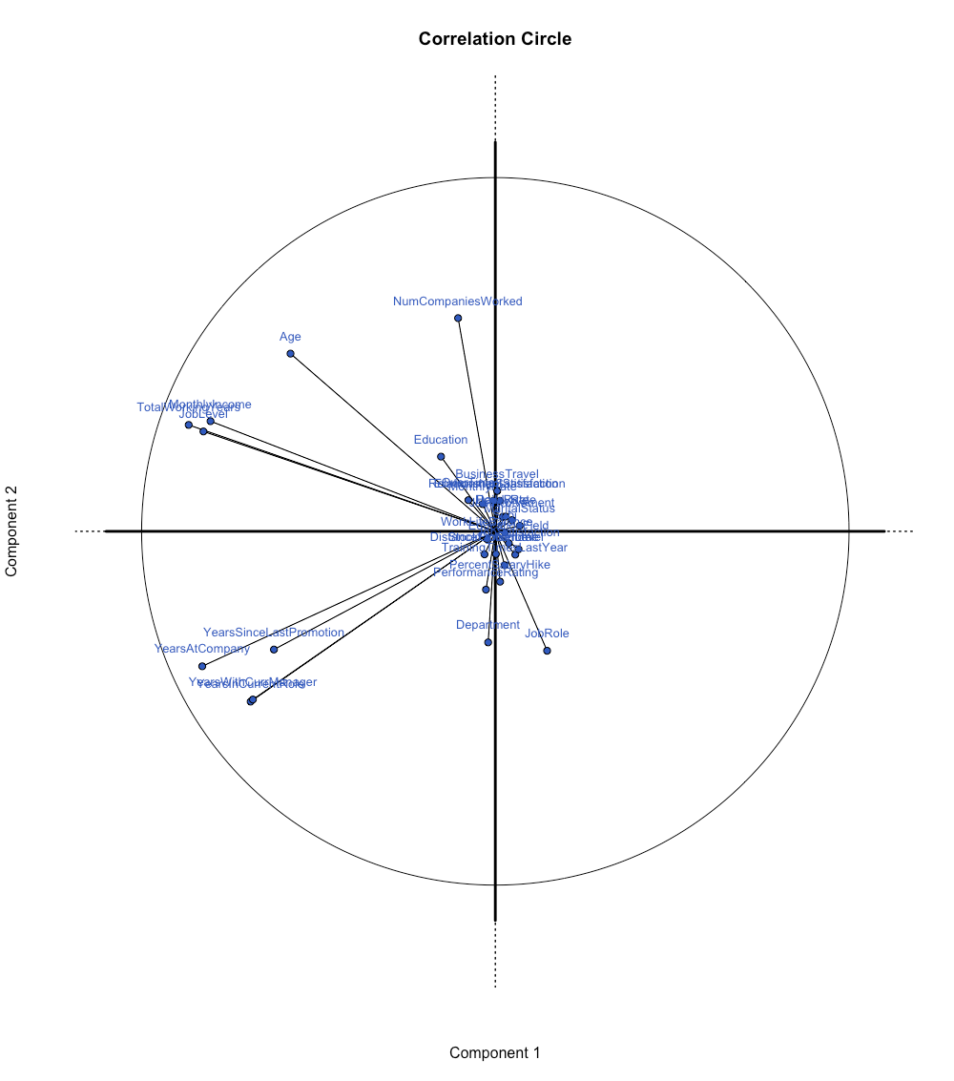
Factor scores and Correlation Circle

Slide 8
Conclusion
Component 1
Rows: Females VS Males
Cols: Years at Company &TotalWorkingYears
Interpret: The females have more years of working experience
Component 2
Rows: Human Resources VS Research and Development
Cols: Performance Rating VS NumCompaniesWorked
Interpret: People who have worked in more number of companies usually go to R&D domain.
Also, people in Human Resources type have higher PerformanceRating

Slide 9
Questions or comments?

